Slide 1
How to be a
Super Speller!

Slide 2

Step 1
Listen to the
word carefully.

Slide 3

Step 2
Put the word in
your head and
repeat it over and
over.

Slide 4

Step 3
Break up (or segment)
the word.
Robot Arms!

Slide 5

Step 4
Start with the bits
you know!

Slide 6
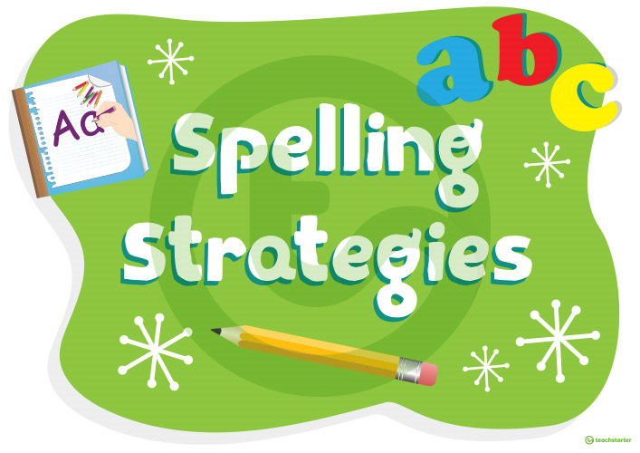
Step 5
Use your spelling
knowledge and
strategies.

Slide 7
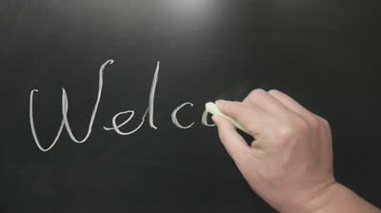
Step 6
Write the word out
properly. Compare your
options!

