Slide 1
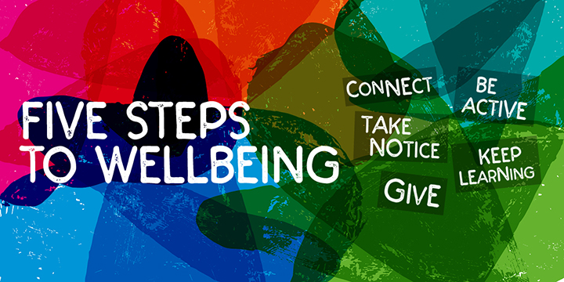

Slide 2
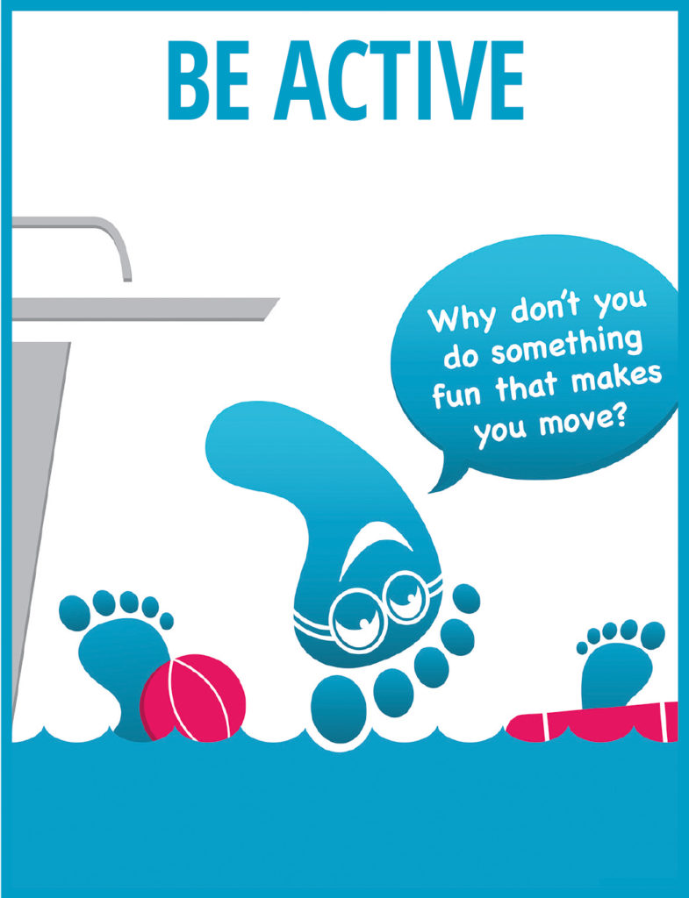

Try and keep moving as much as possible during the day.
Any form of exercise will help to keep you both physically and mentally healthy.
Choose a form of movement which you enjoy and which may also help you connect with other people.
Remember that keeping active is not just about sport and going to the gym – walking the dog; skimming stones at the beach; playing in the park; helping with household chores are all forms of movement.

Slide 3
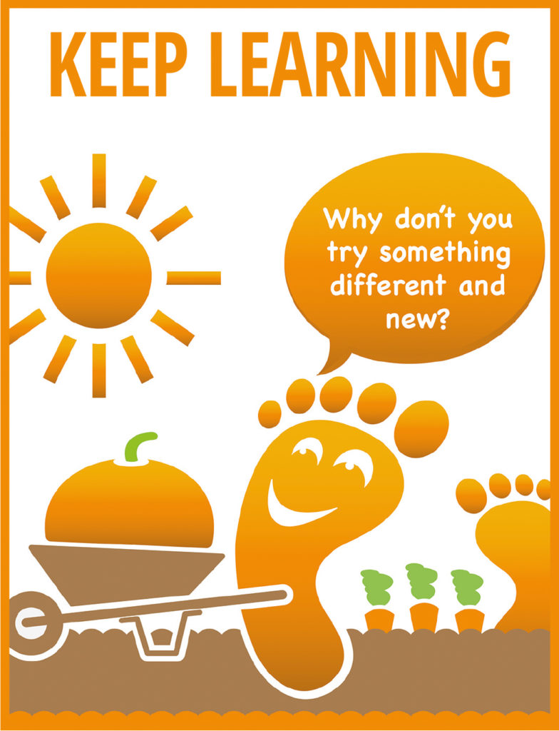
Maybe try helping an adult prepare a meal fro the family.
Maybe try taking on a new project, such as fixing a broken bike; planting some seeds in the garden; painting a picture.
Maybe try a new hobby that challenges you or that you could start doing with a friend – there are lots of extra-curricular clubs at school to try.

Slide 4
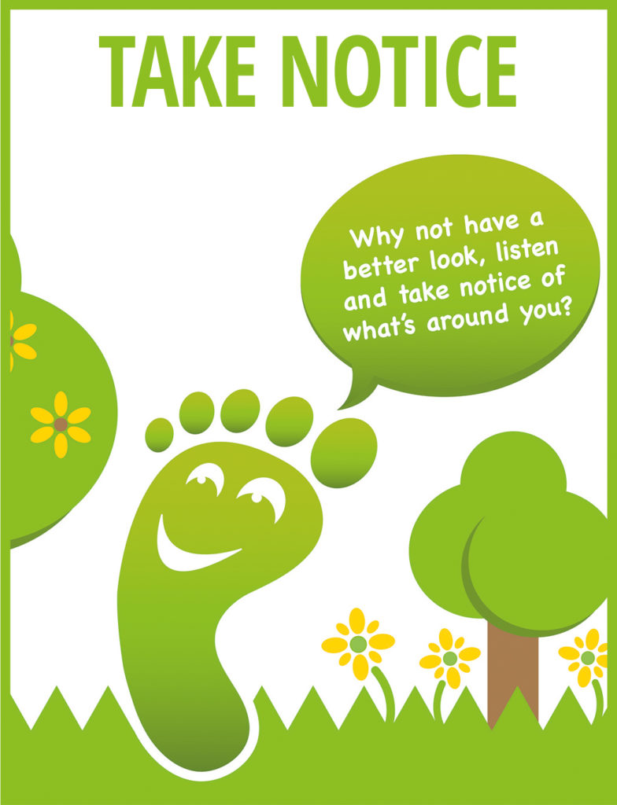
Pay more attention to the present moment to help improve your mental wellbeing. This includes your thoughts and feelings, your body and the world around you.
Some people call this "mindfulness". Mindfulness can help you enjoy life more and understand yourself better. It can positively change the way you feel about life and how you approach challenges.

Slide 5
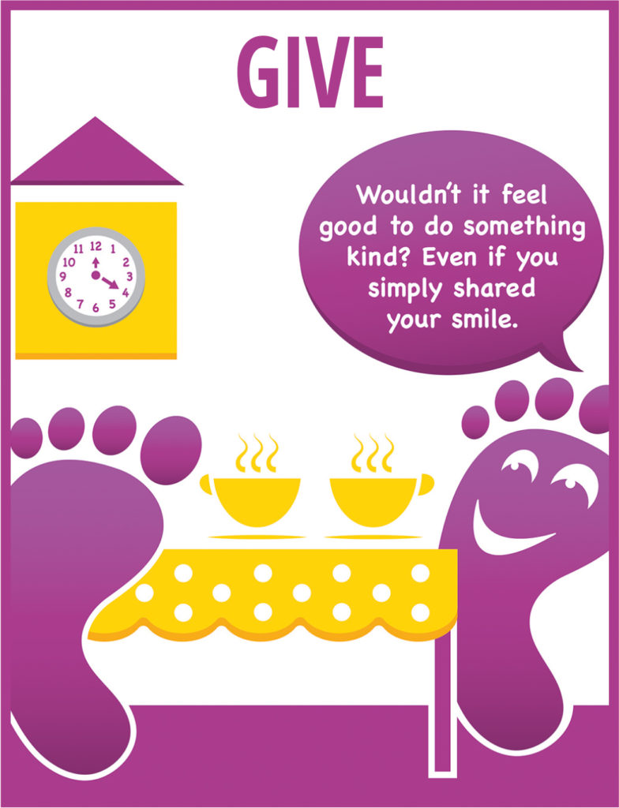
Say thank you to someone for something they have done for you.
Asking friends or family how they are and really listen to their answer
Spending time with friends or relatives who need support or company
Offering to help someone with something around the house.
Volunteer to do something kind and helpful for a known neighbour.

Slide 6
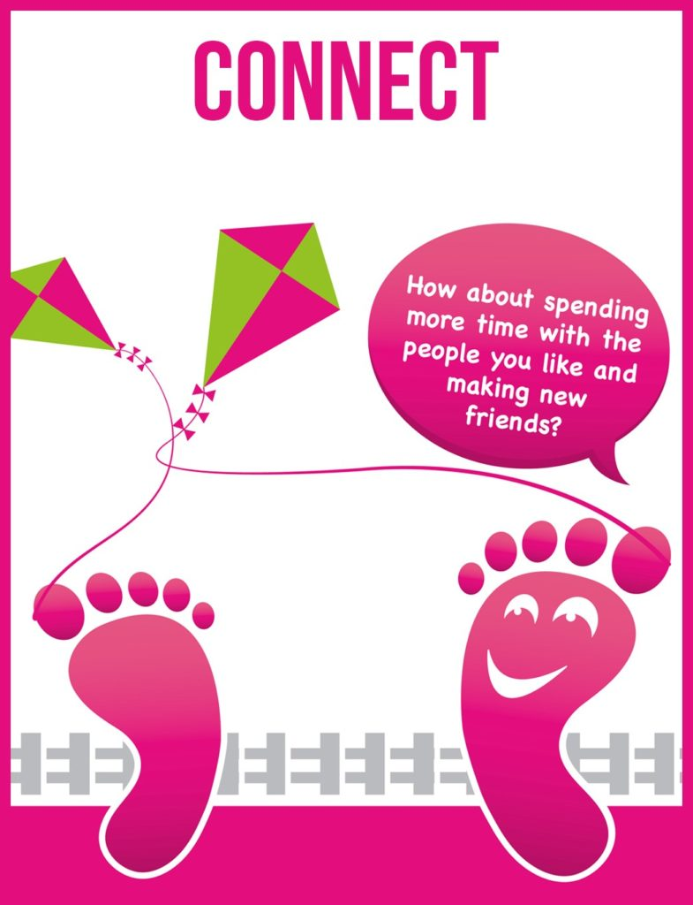
Take time each day to be with your family e.g. try and eat a meal altogether.
Try and spend time with your friends.
Switch off the TV or your screens to talk or play a game with your family or friends.
Visit a friend or family member who needs support or company
Use technology to stay in touch with friends and family especially if you live far apart.
Do something kind for a neighbour e.g. bake a cake, make a card, draw a picture.

