Slide 1


We have a new BPSP challenge for you…

Slide 2
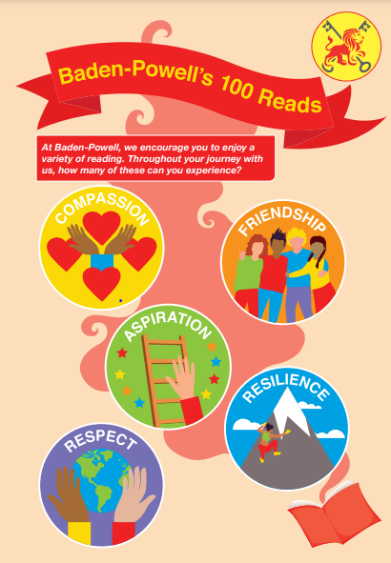
Do you think you could read 100 different types of texts during your time at Baden-Powell?

Slide 3
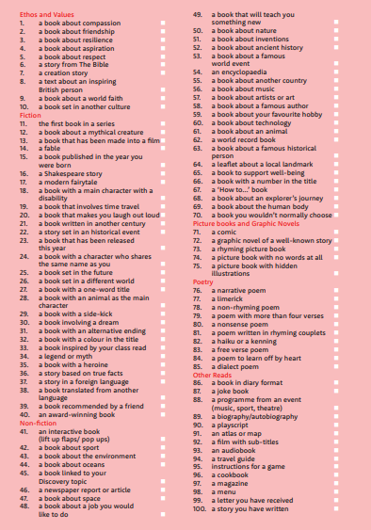

The adults of BPSP have put together 100 different types of read for you to enjoy…

Slide 4
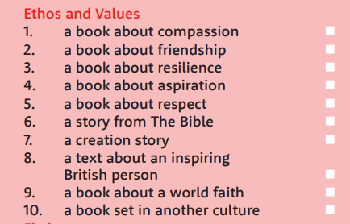



Let’s take a closer look…
Can you find and enjoy texts and books linking to our school values?

Slide 5
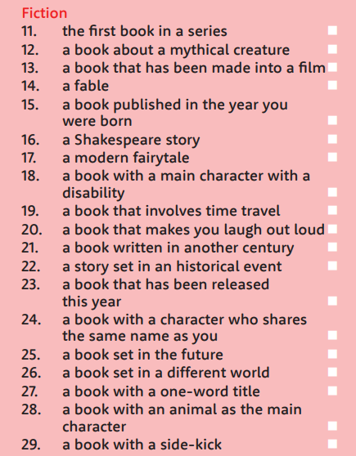
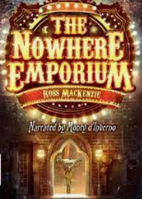
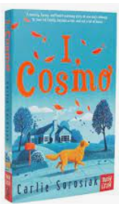

Are you a fan of fiction?
What book are you reading at the moment? Does it link to any of these?
Share some recommendations as a class!

Slide 6
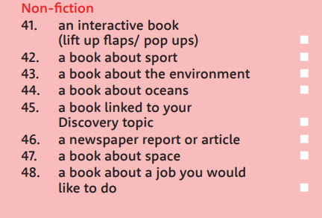
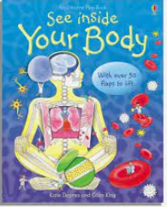

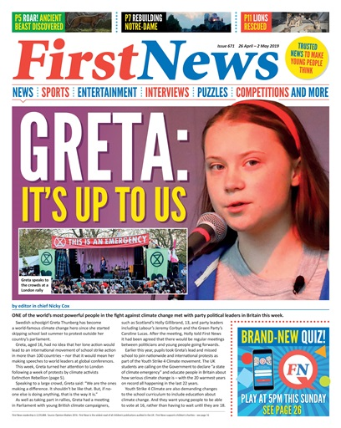
How much non-fiction do you read?
We bet you’ve read one of these before!
Where can you look for good non-fiction books?

Slide 7

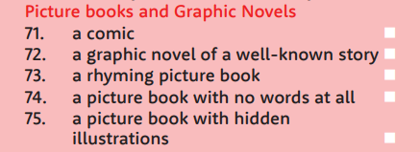


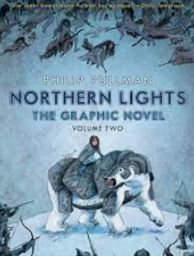
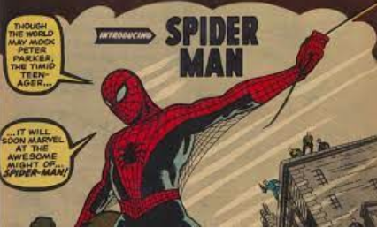
When was the last time you enjoyed a picture book or graphic novel?

Slide 8


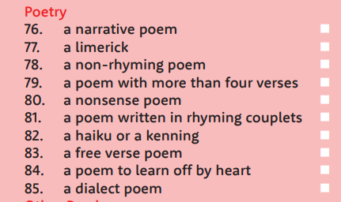


Poems are quick and easy! Have you read any of these before?

Slide 9
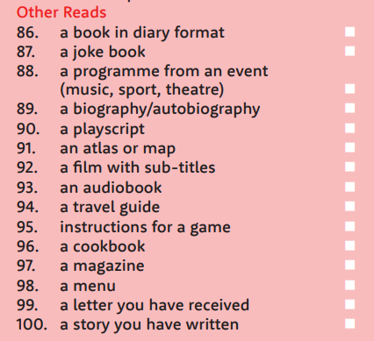
Or try something completely different!
Which of these would you start with?

Slide 10

Some of your questions answered…

Slide 11

You can enjoy a text by reading it on your own, with a friend or being read to.

Slide 12
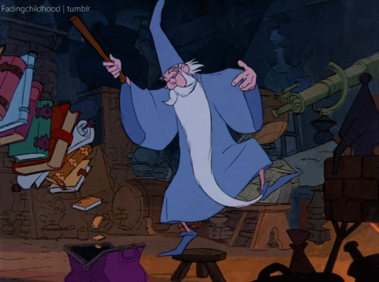
You can read the texts in any order and jump between categories!

Slide 13

This challenge might be completed in a year… or it might take all four years of your time at BPSP.
You will keep your challenge card every time you move year groups (no starting again!)
The challenge starts now… you can’t backdate reads.

Slide 14


When you hit 25 texts, 50 texts and 75 texts, you will be awarded a certificate.

Slide 15

100 texts = you will win a book from
Mrs. Rusling’s book shelf!

Slide 16

Not sure what to read?
Head to our school website where teachers will be sharing recommendations for each category.

Slide 17

When you’ve read a text, simply tick it off and date it. Your teacher will ask you what texts you have been enjoying.

Slide 18

How many can you tick off before the end of the
year?
Enjoy reading, BPSP!

