Slide 1
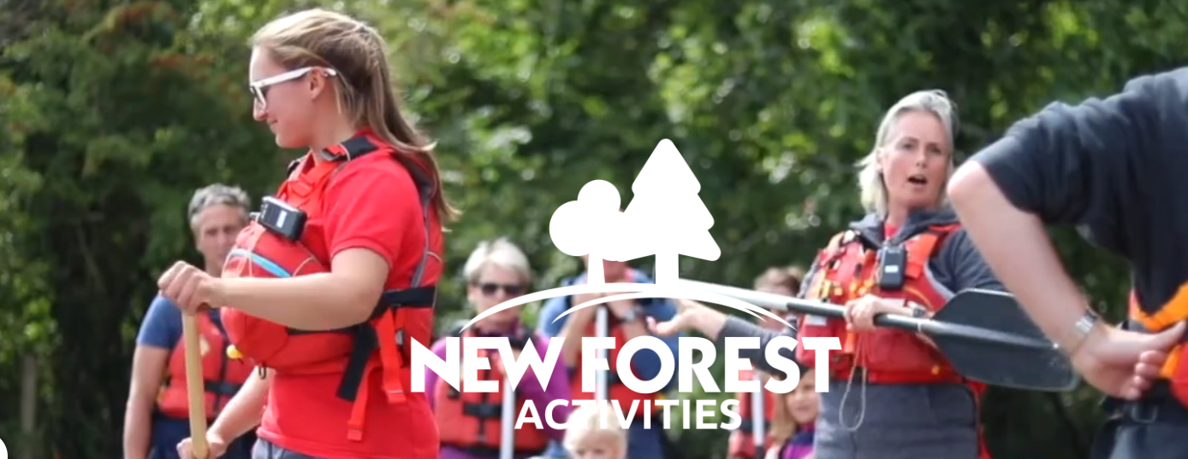
Welcome

Slide 2
Trip Dates:
Trip 1: 6JB, 6DG & 6KF: Monday 29 June – Wednesday 1 July
Trip 2: 6SL, 6MH & 6GJ: Wednesday 1 July – Friday 3 July

Slide 3
Drop off and pick up
Morning of drop off: Please drop your child off at school at between 8.00-8.30am. They will need to come straight to the sports hall.
Pick up: On the date of return, we are planning to be back for the end of the day (3.00-3.20pm). Please collect your child from the field upon arrival. If you are unable to collect your child before 3.20pm, their normal home arrangements will apply.

Slide 4
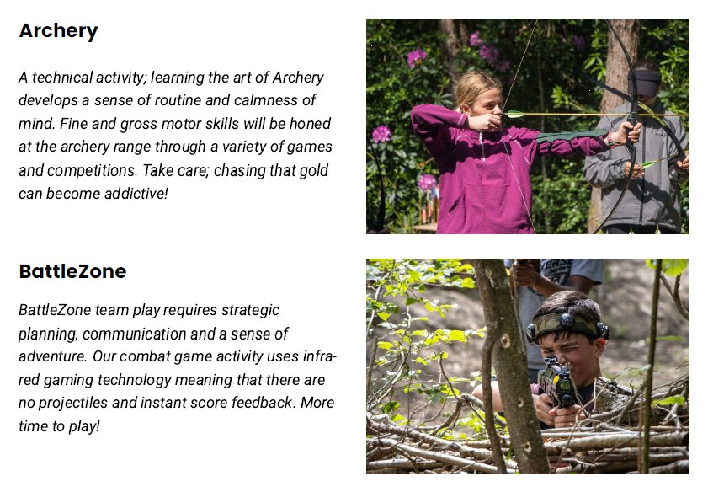

Slide 5
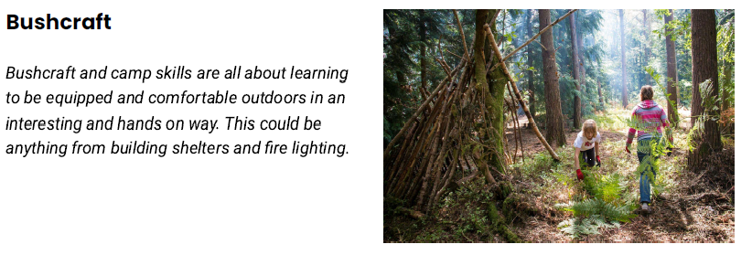
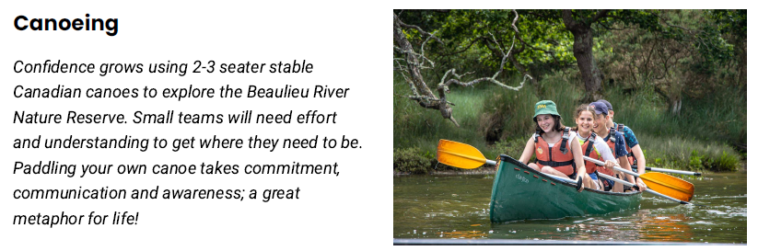

Slide 6
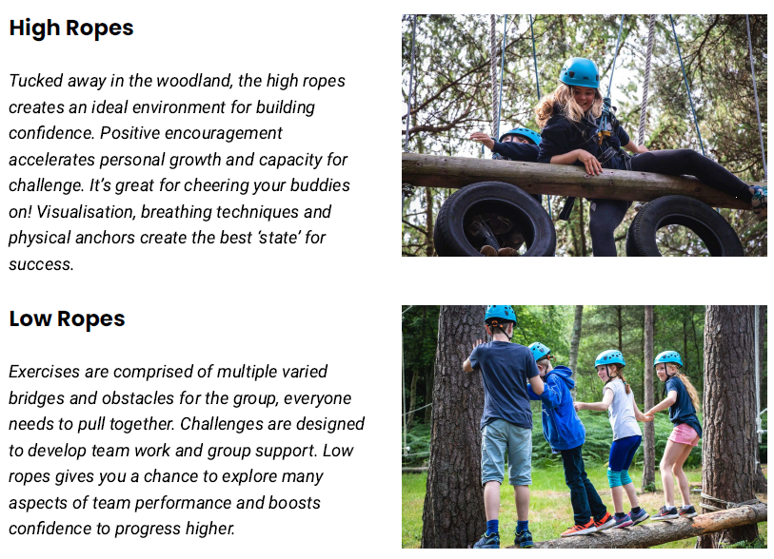

Slide 7
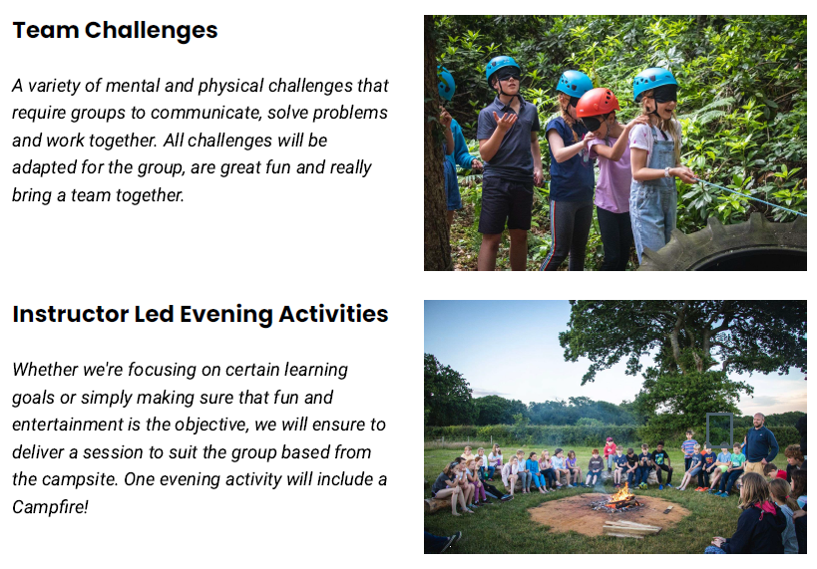

Slide 8
Trip timetable
Day 1 PM - Canoeing and BattleZone (approx 40 per site)
Day 2 ALL DAY - Rotations including Team Challenges, Archery, High Ropes and Bushcraft
Day 3 AM - Caneoing and BattleZone (swap from Day 1)
Notes:
Each camp divided into 4 groups of about 18-20 participants per group.

Slide 9
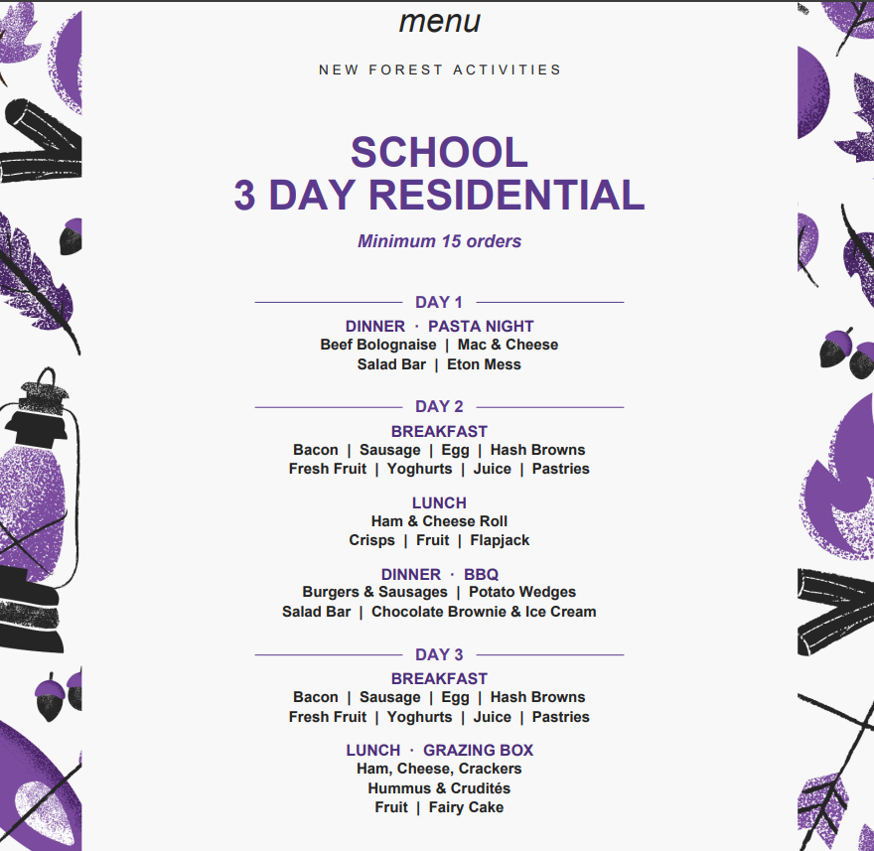
Notes:
Dietary requirements form has been passed onto NAC and they will provide appropriate food for these children.

Slide 10
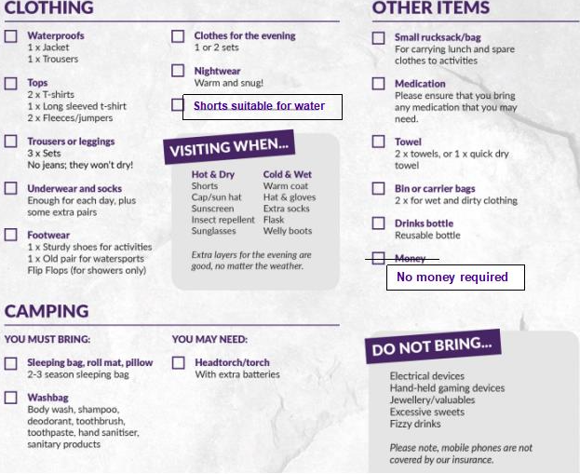
A disposable camera is permitted but no digital cameras please.
No electronic equipment at all.
Comfort toy/item for your child should they need it.
Comfort letter for your child should they want it (packed into their own bags).
No sweets.
Packed lunch on first day.
Please note our addition to the kit list: shorts suitable for water needed for both boys and girls – swimming kits not needed, just shorts for kayaking.

Slide 11
Tents - between 4-8 children per tent. Each camp divided into 4 groups of about 18-20 participants per group.
Food – dietary requirements forms completed.
Behaviour
Top tips – flip/flops or sliders are a must, insect spray, communication from us, pre-trip worries, sleep mask, big water bottle.
Medicines - hayfever

Slide 12
Any questions?

