Slide 1


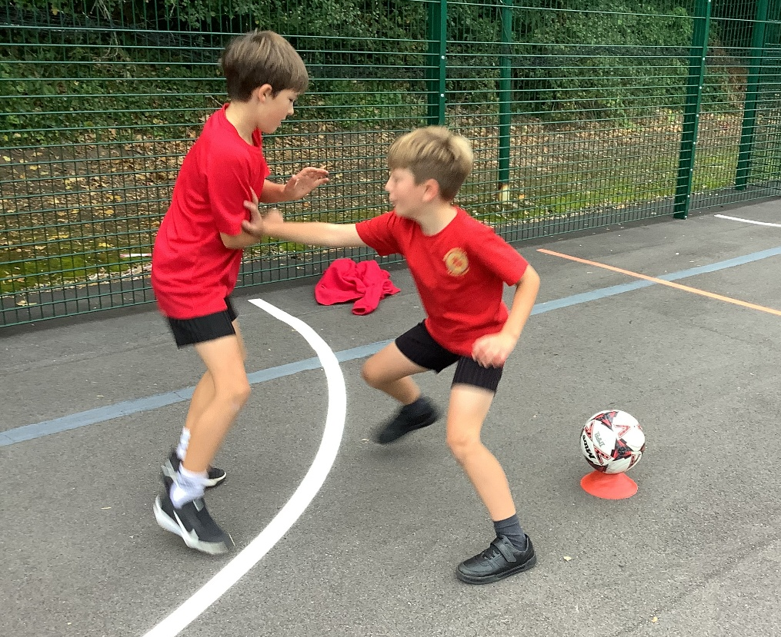
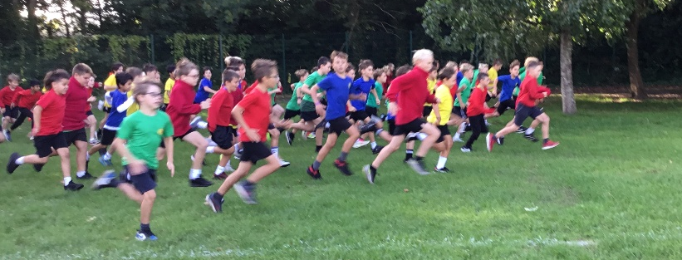
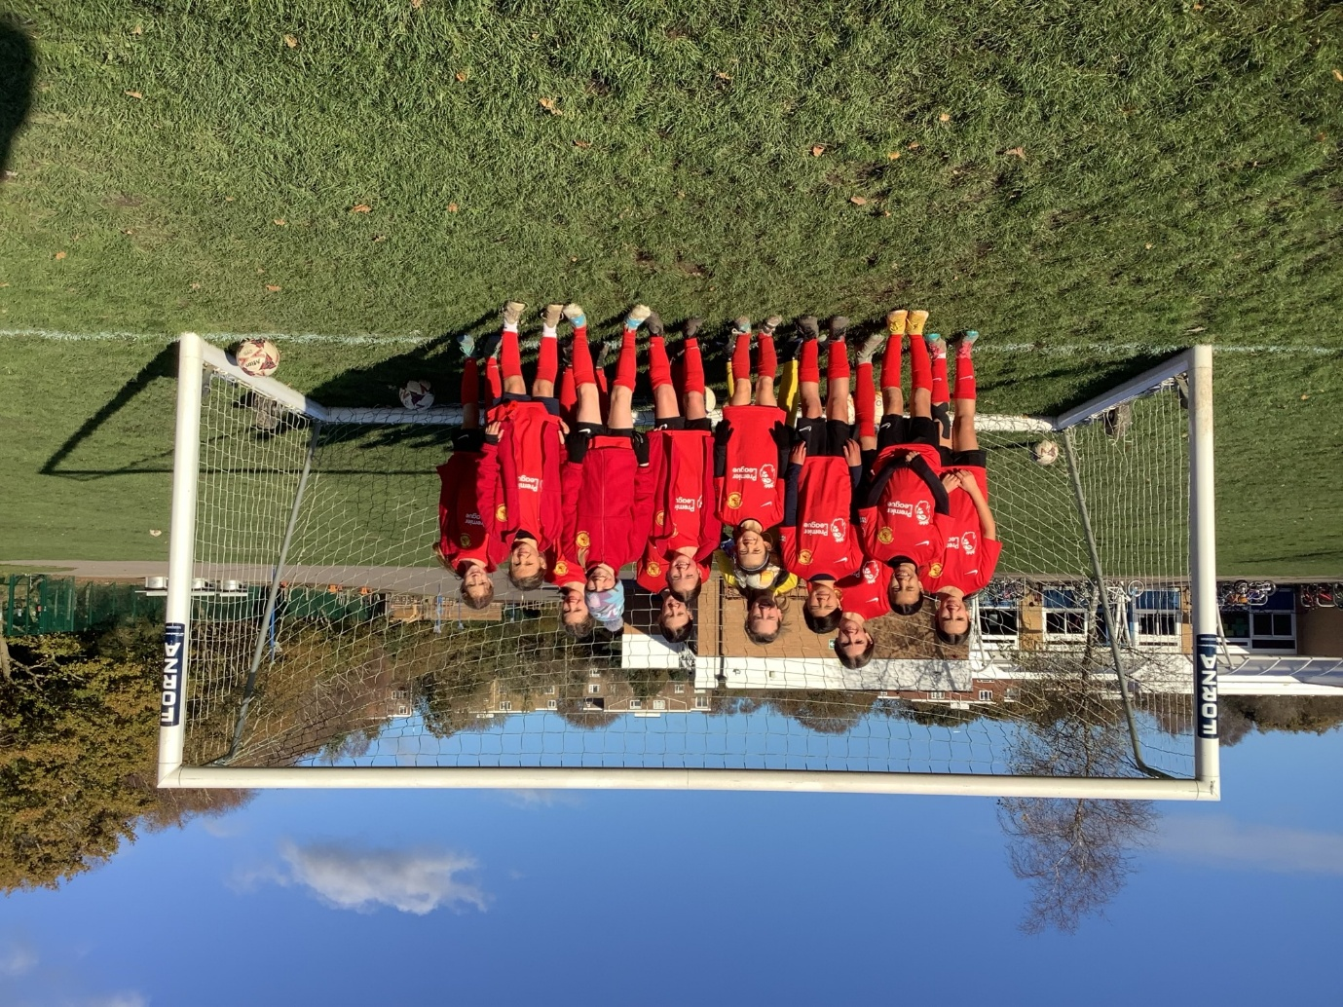


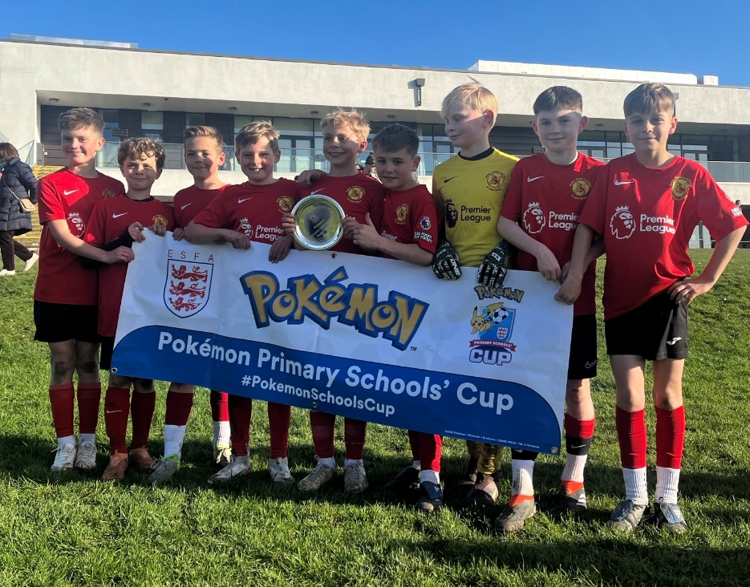
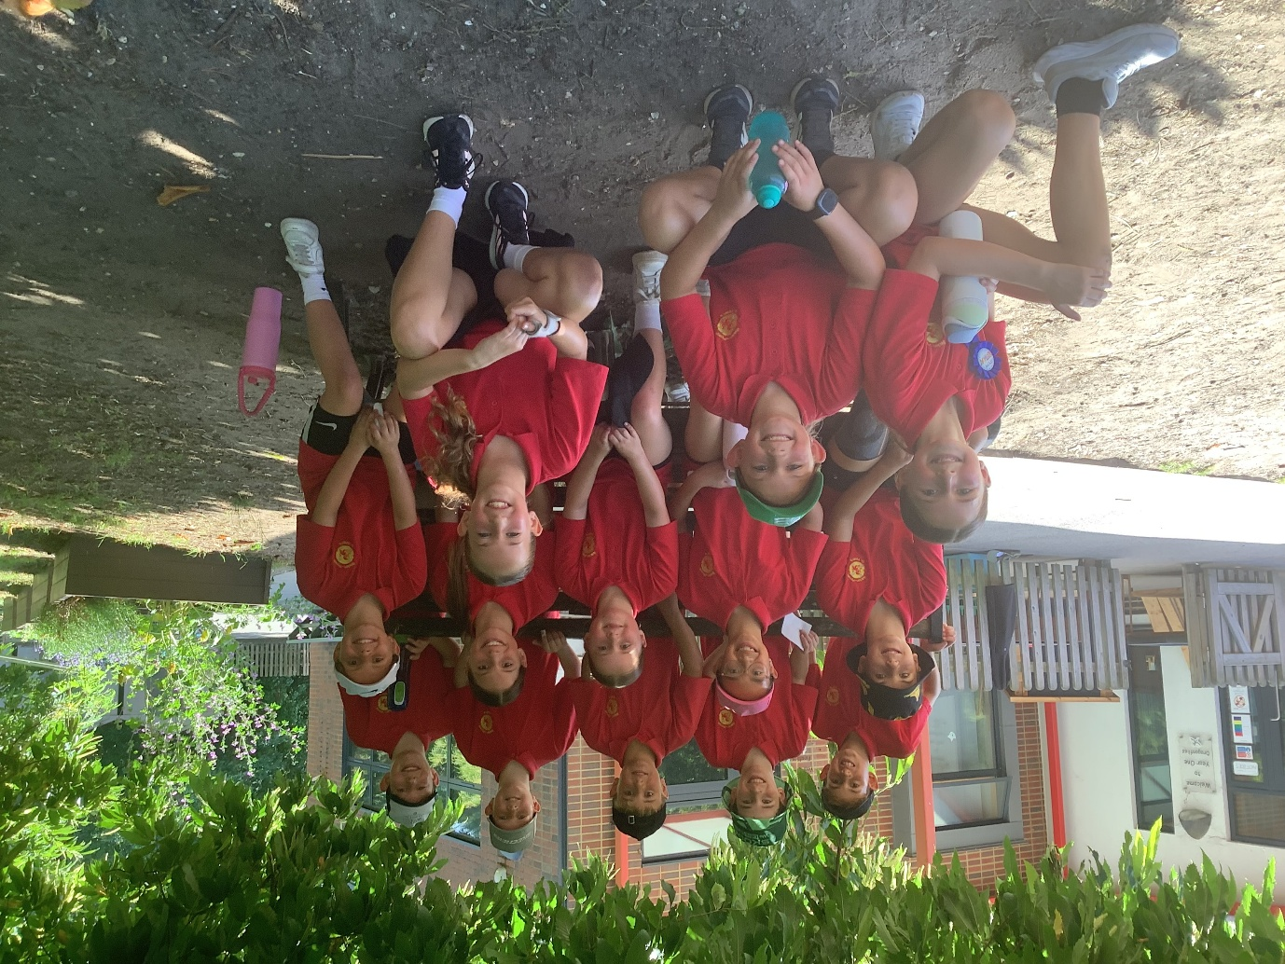
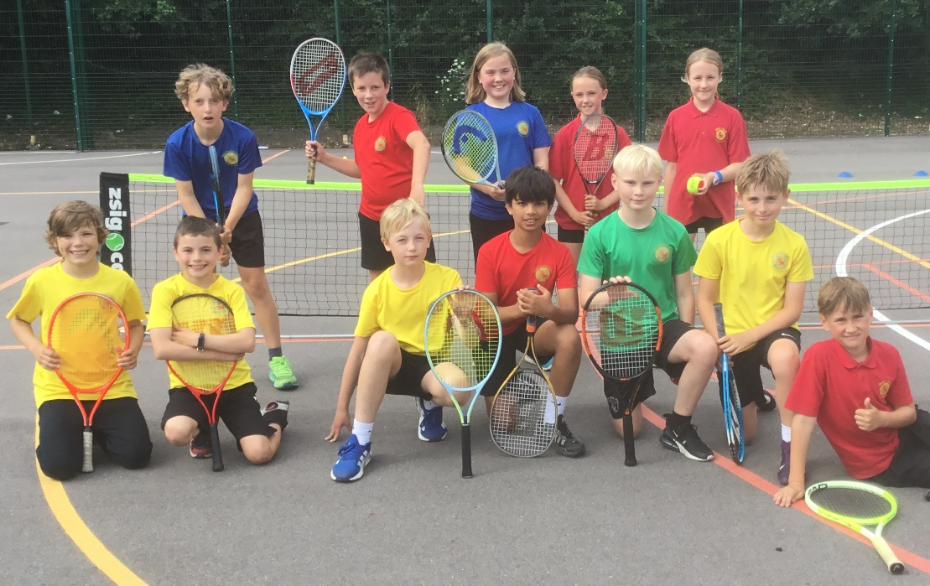
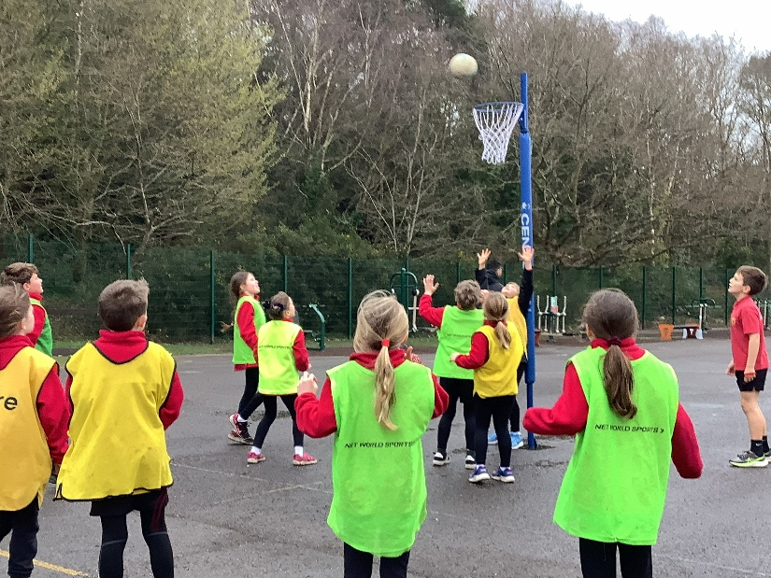
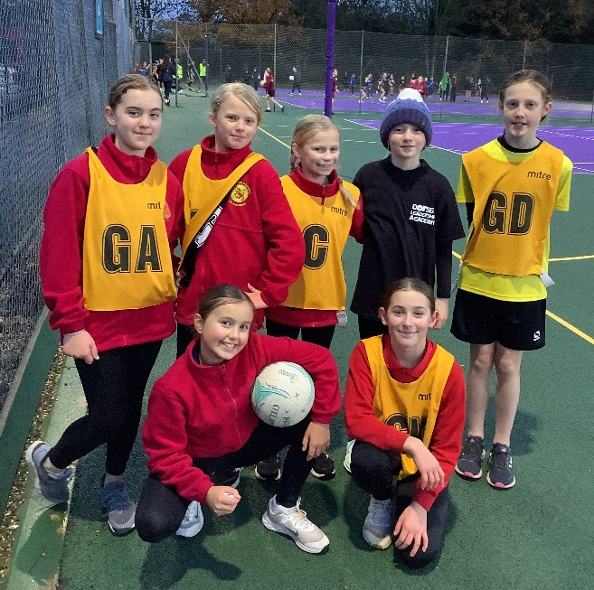
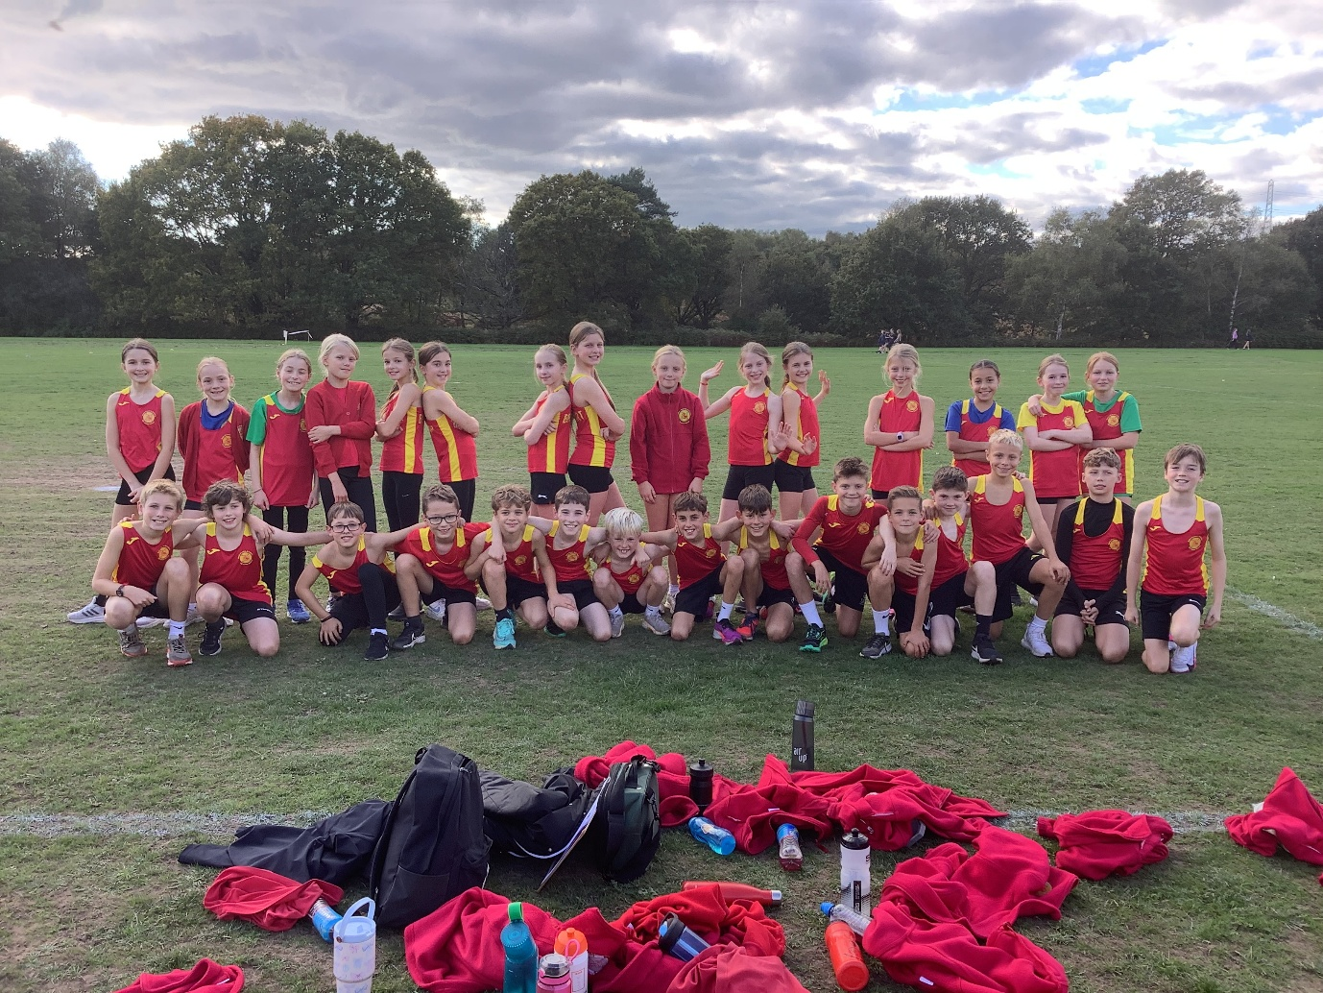
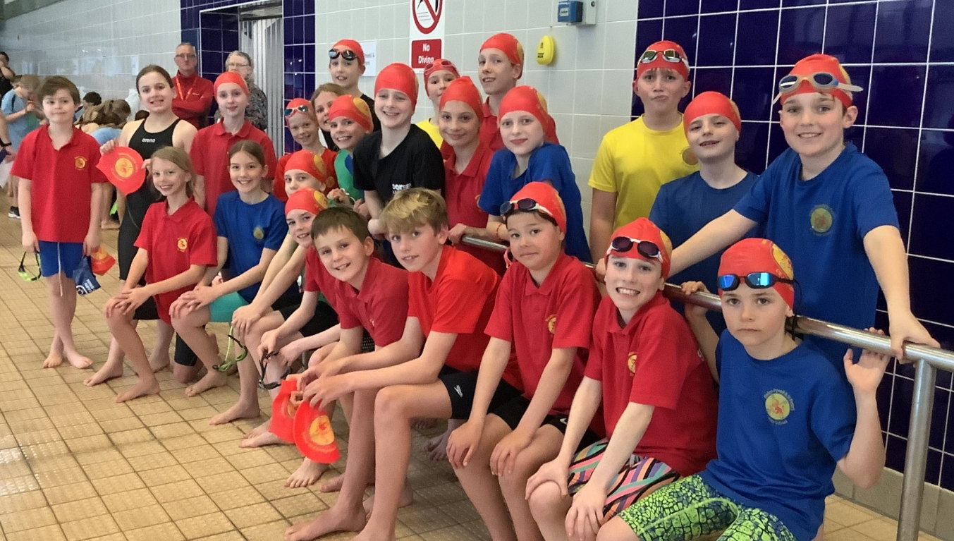
Baden-Powell & St. Peter’s CE Junior School
PE and Sport Premium 2025/26

Slide 3

Aims for the next academic year (2025/2026)
Using your whole school priorities, school development plan and previous PE, school sport and physical activity data, set out your aims for the year ahead.
Think about specific areas of need such as inactive girls, SEND and disadvantaged pupils
Remember to also input your swimming data and reflections in the table located at the bottom of this page.
Consider which of the 5 key areas improvements will be focusing on:
1. Increasing confidence, knowledge and skills of all staff in teaching PE and sporting activities prioritising CPD and training where needed.
2. Increasing engagement of all pupils in regular physical activity and sporting activities
3. Raising the profile of PE and sport across the school, to support whole school improvement
4. Offer a broader and more equal experience of a range of sports and physical activities to all pupils and ensure equal access to sport for boys and girls
5. Increasing participation in competitive sport
Swimming and Water Safety | What went well? Supporting evidence? | What didn't go well? Supporting evidence?
1. Swim competently, confidently and proficiently over a distance of at least 25 metres | 98% High quality swimming lessons delivered as part of the PE curriculum for all pupils
2. Use a range of strokes effectively (for example, front crawl, backstroke and breaststroke) | 97% Each child receiving at least a term’s worth of swimming lessons.
3. Perform safe self-rescue in different water-based situations | 81% Safe self-rescue in different situations taught within the swimming lessons. | There has been no increase in the number of pupils from last year successfully performing safe-rescue. Next year, double the number of safe self-rescue themed lessons.

Slide 4
Your objective: Develop teachers’ confidence in delivering high quality PE lessons.
 | Intent - what is your objective? | Implementation - How will you achieve this? | Impact - What do you hope to see? | Supporting evidence
Plan and monitor (Complete now and monitor) | Develop teachers’ confidence in delivering high quality PE lessons. | Continue with a PE team teaching programme for targeted teachers who, survey results show, are feeling less confident or competent leading high quality PE lessons at present. | Targeted teachers engaging with the PE team teaching programme, working alongside and observing PE specalists and improving their confidence and competence to deliver high quality PE lessons across a range of PE units. | Survey completed by the teachers involved in the PE team teaching programme. Learning walks involving these teachers and termly meetings with the PE specialists to evaluate what impact is being seen.
 | What impact have you seen? | Are the improvements sustainable? How? | Supporting evidence | Approx. cost
Evaluate (Complete in July) | Teachers involved in the PE team teaching programme have seen a large improvement in the confidence they have to deliver high quality PE lessons. When comparing the quality of PE lessons observed during Autumn and Summer learning walks, there was an improvement in the engagement and learning of the pupils. | Improvements are sustainable as teachers can take their improved confidence into future PE lessons where they will be teaching the same PE lessons each year. Termly meetings and top up PE CPD sessions will be carried out with all teachers to ensure their confidence and skills in delivering PE remain up to date. | Survey results from teachers have all shown they feel more confident and competent in delivering high quality PE lessons. | PE team teaching programme - £3795

Slide 5
Your objective: Develop lunchtime play provision to increase activity for least active groups.
 | Intent - what is your objective? | Implementation - How will you achieve this? | Impact - What do you hope to see? | Supporting evidence
Plan and monitor (Complete now and monitor) | Develop lunchtime play provision to increase activity for least active groups. | Develop lunchtime provision by offering multiple activities taking place which will be led by sports leaders and overseen by a specialist sports coach. Offer new activities by purchasing new equipment. Develop a new ‘lunchtime club’ in the sportshall for SEND children who are not currently physically active at lunchtimes. | An increase in the number of pupils joining in with the lunchtime activities provided by the sports leaders. Pupils who are currently disengaged at lunchtimes and are not physically active, becoming physically active by joining in with one of the activities or by attending ‘lunchtime club’ | Half termly observations of lunchtime provisions to assess the number of pupils engaging. Weekly surveys completed by sports leaders and a daily register kept by specialist sports coach who is overseeing the activities.
 | What impact have you seen? | Are the improvements sustainable? How? | Supporting evidence | Approx. cost
Evaluate (Complete in July) | There has been an increase in the number of pupils being physically active at lunchtimes and joining in with the activities led by sports leaders including previously disengaged pupils. All SEND children who have been invited to ‘lunchtime club’ have attended and been physically active. | The improvements are sustainable by continuing the provision next year. To ensure engagement remains high, pupil voice will be used to ascertain what type of activities pupils would like to be offered moving forwards. | Half termly observations and sports leader surveys all showed an increase in the number of pupils taking part in the activities when comparing the start of Autumn term to the end of Summer term. | New Equipment - £3979 Sports Leader t-shirts - £746 PE specialist - £3095

Slide 6
Your objective: Develop extra-curricular inter school offering so more children are attending sporting and physical activity events outside of school hours.
 | Intent - what is your objective? | Implementation - How will you achieve this? | Impact - What do you hope to see? | Supporting evidence
Plan and monitor (Complete now and monitor) | Develop extra-curricular inter school offering so more children are attending sporting and physical activity events outside of school hours. | Entering all inter school sporting opportunities provided by Poole and East Dorset School Sports Association (PEDSSA) and the Dorset School Games programme and organising further opportunities with other local schools. Ensure opportunities for children to take part are as broad as possible whilst following event categories descriptors and guidance set out in the PE and Sport Policy. Upskill new members of staff so they feel confident enough to attend sporting events with pupils. | An increase in the number of pupils invited to take part in extra curricular sporting opportunities when compared to 2024/25. New members of staff feeling more confident to attend sporting events with pupils. | Tracking which pupils across the whole school (and the number of pupils) who are invited to extra-curricular.
 | What impact have you seen? | Are the improvements sustainable? How? | Supporting evidence | Approx. cost
Evaluate (Complete in July) | There has been an increase in the number of pupils invited to extra-curricular inter school events compared to the previous academic year (2024/25). | By ensuring we continue to enter as many inter school sporting opportunities as possible, upskilling a couple more new members of staff with their confidence to attend these events and continuing to track invites, these improvements are sustainable. | Tracking document shows the number of pupils invited and attending inter school sporting opportunities has increased compared to the previous year. Four new members of staff, who had previously not attended a sporting event, have attended at least one event this year. | Supply cover - £2000 Event entry fees - £534 Travel and accommodation - £512

Slide 7
Your objective: Develop extra-curricular club provision so more girls are active beyond the school day.
 | Intent - what is your objective? | Implementation - How will you achieve this? | Impact - What do you hope to see? | Supporting evidence
Plan and monitor (Complete now and monitor) | Develop extra-curricular club provision so more girls are active beyond the school day. | Continue to offer a free to parents ‘All Years Girls Football After School Club’ to all 360 girls at the school. Pay for two PE specialist coaches to run this after school club each week. | At least 50 girls attending and enjoying this weekly girls football club. | Weekly club registers and club learning walks.
 | What impact have you seen? | Are the improvements sustainable? How? | Supporting evidence | Approx. cost
Evaluate (Complete in July) | There are now more girls being active after school by attending this girls football club each week. A percentage of the girls attending are eligible for pupil premium funding. The girls are enjoying playing football and are attending each week. | Improvements are sustainable by continuing to carry out club learning walks, giving feedback to the specialist coaches to ensure the quality of the club remains high and the girls in attendance continue to enjoy it. | Weekly registers show the number of girls attending the club each week. | Specialist coaches x 2 - £2136

Slide 8
Your objective: Improve the quality of PE lessons being taught so children who are less active become more active and learn more during PE lessons.
 | Intent - what is your objective? | Implementation - How will you achieve this? | Impact - What do you hope to see? | Supporting evidence
Plan and monitor (Complete now and monitor) | Improve the quality of PE lessons being taught so children who are less active become more active and learn more during PE lessons. | Termly learning walks of PE and Games lessons offering detailed feedback to each PE specialist involved. Feedback to highlight areas of delivering which went well, areas to be targeted for improvement moving forwards and practical suggestions for how to improve these areas. | An improvement in the quality of PE lessons delivered by the PE specialists, with the number of ‘active minutes’ being prioritized. PE specialists achieving targets set. | Termly learning walks of PE and Games lessons.
 | What impact have you seen? | Are the improvements sustainable? How? | Supporting evidence | Approx. cost
Evaluate (Complete in July) | There has been an increase in the quality of PE and Games lessons being delivered by PE specialists. The two main areas of improvement have been behaviour management and effective modelling and questioning. As a result of improvements, children, on the whole, are now more active during PE and Games lessons compared to previously. | PE specialists can take these improvements in their delivery into all future PE and Games lessons. Termly learning walks will continue to ensure PE specalists continue to feel valued whilst also being aware of areas to improve and how to improve these areas. | Feedback sheets from termly learning walks | No cost

